Slide 1
NAF Auction
MWR Spring Clean Out
*May 25th-June 9^{th*}
Minimum Bids will be noted on slides in RED Letters
Not all items require a minimum bid
Please copy & paste the link below to fill out an auction bid form.
Once completed please email to: Fabiana.tapia.naf@army.mil Subject Line: Spring Auction
https://detrick.armymwr.com/application/files/3716/7648/9094/NAF_Auction_Bid_Form_2023_Fab.pdf
POC: Derrick Trautman 301-619-3264

Slide 2
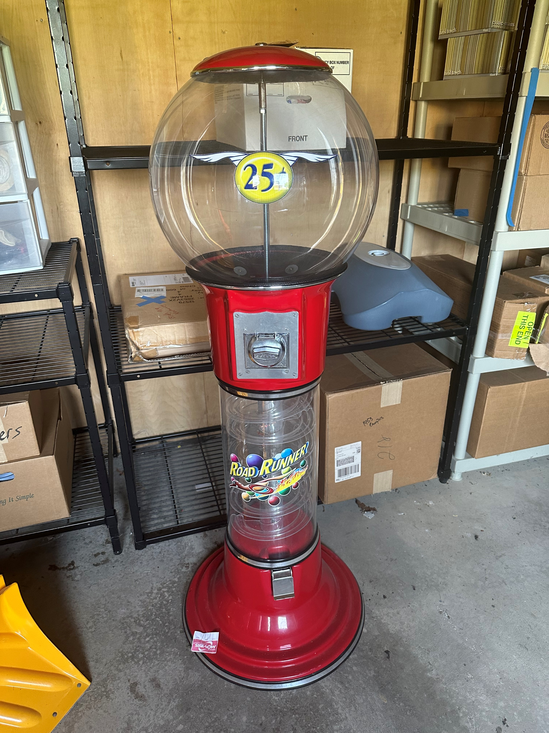
ITEM #1
Gumball Machine

Slide 3
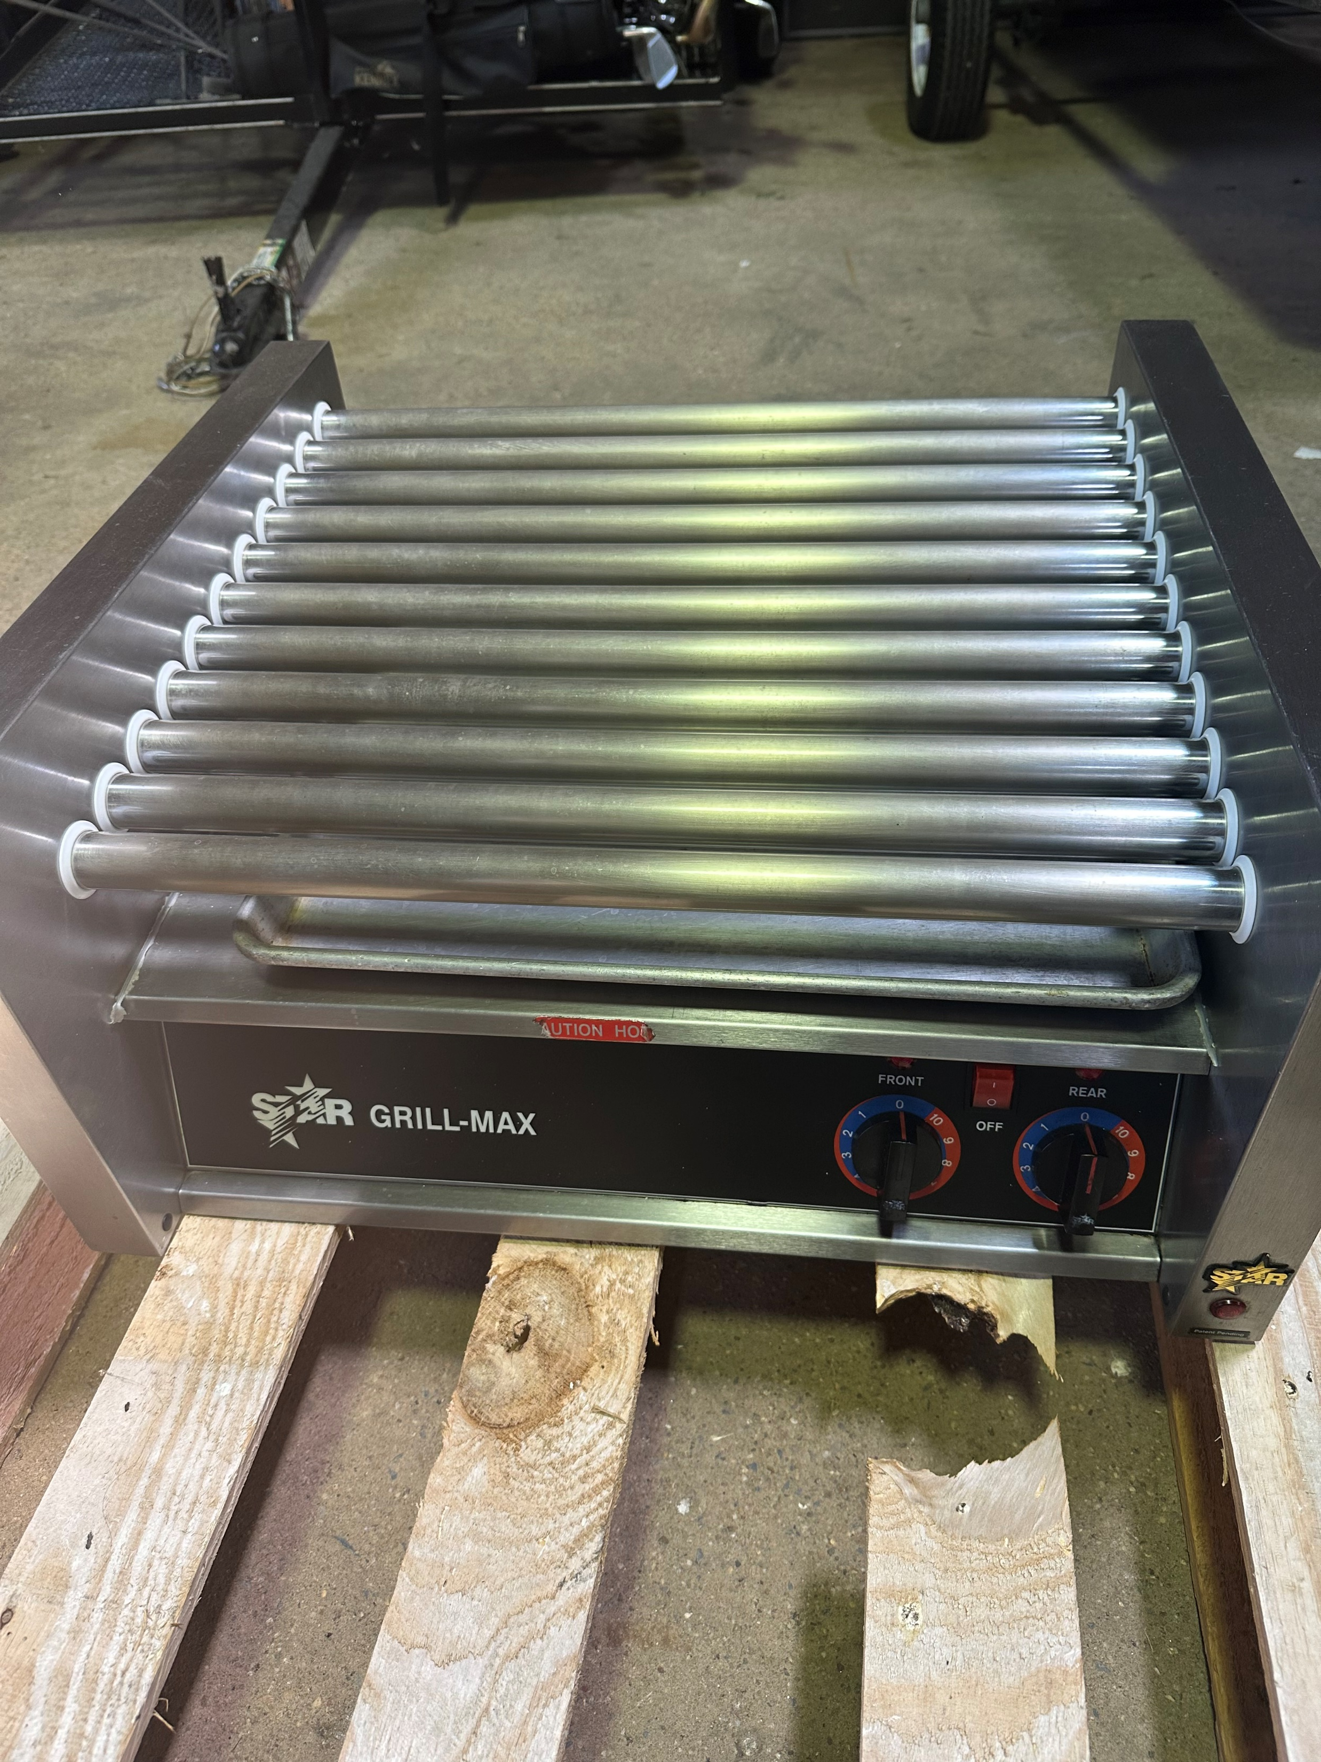
ITEM #2
Hot Dog Grill
This item can be viewed on 1 June from 1000-1200
Location:260 Beasley Drive

Slide 4
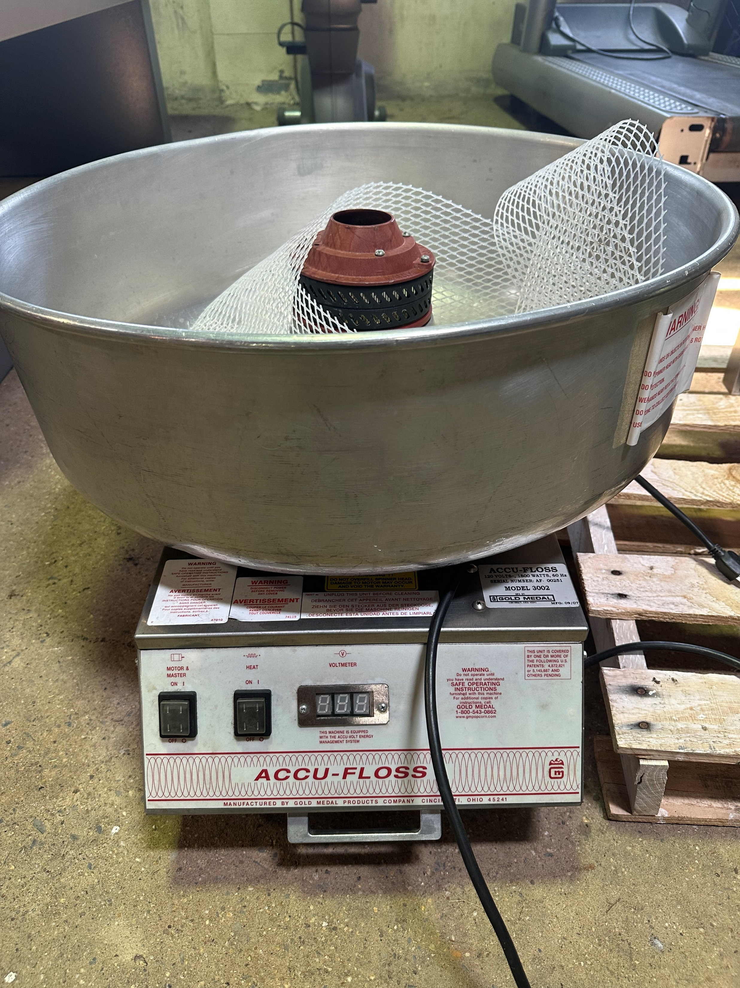
ITEM #3
Cotton Candy Machine
This item can be viewed on 1 June from 1000-1200
Location:260 Beasley Drive

Slide 5
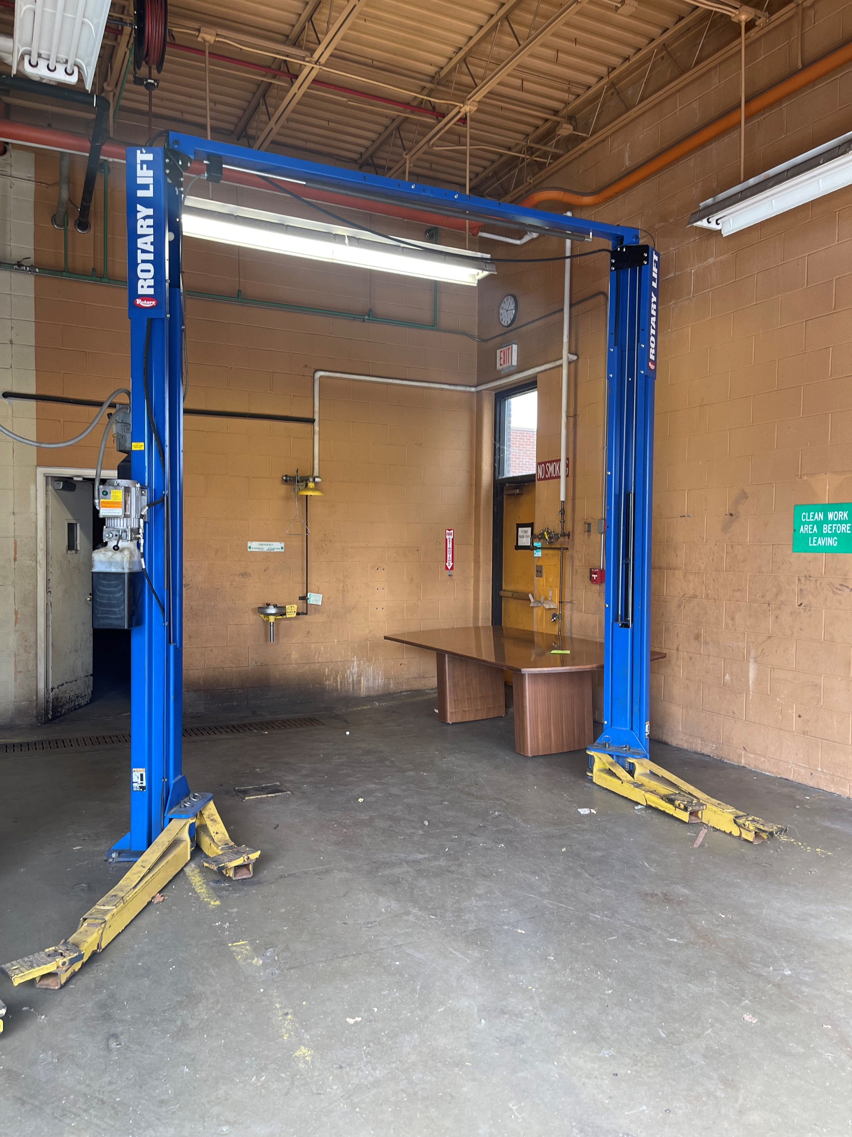
ITEM #4
Rotary Lift
Minimum Bid $1400
This item can be viewed 5 June from 1600-1800
Call 301-6193264 for location address

Slide 6
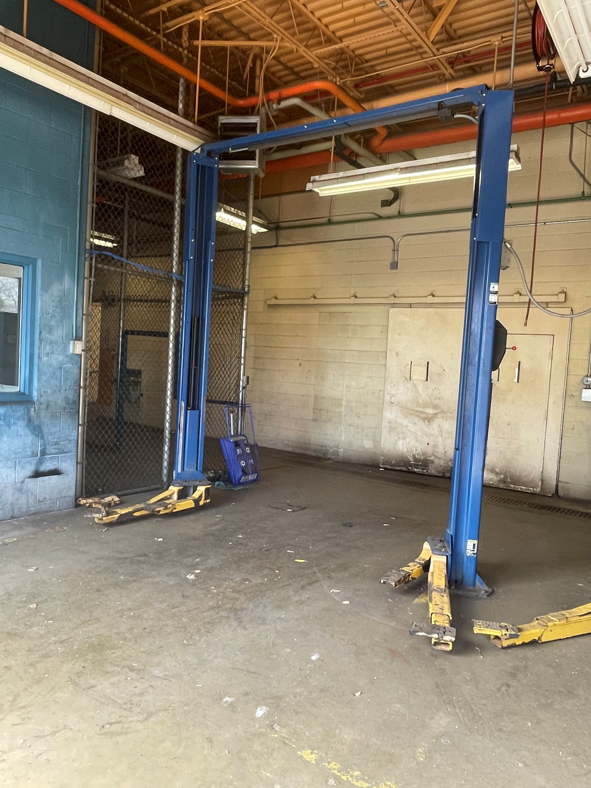
ITEM #5
Rotary Lift
Minimum Bid $1000
This item can be viewed 5 June from 1600-1800
Call 301-6193264 for location address

Slide 7
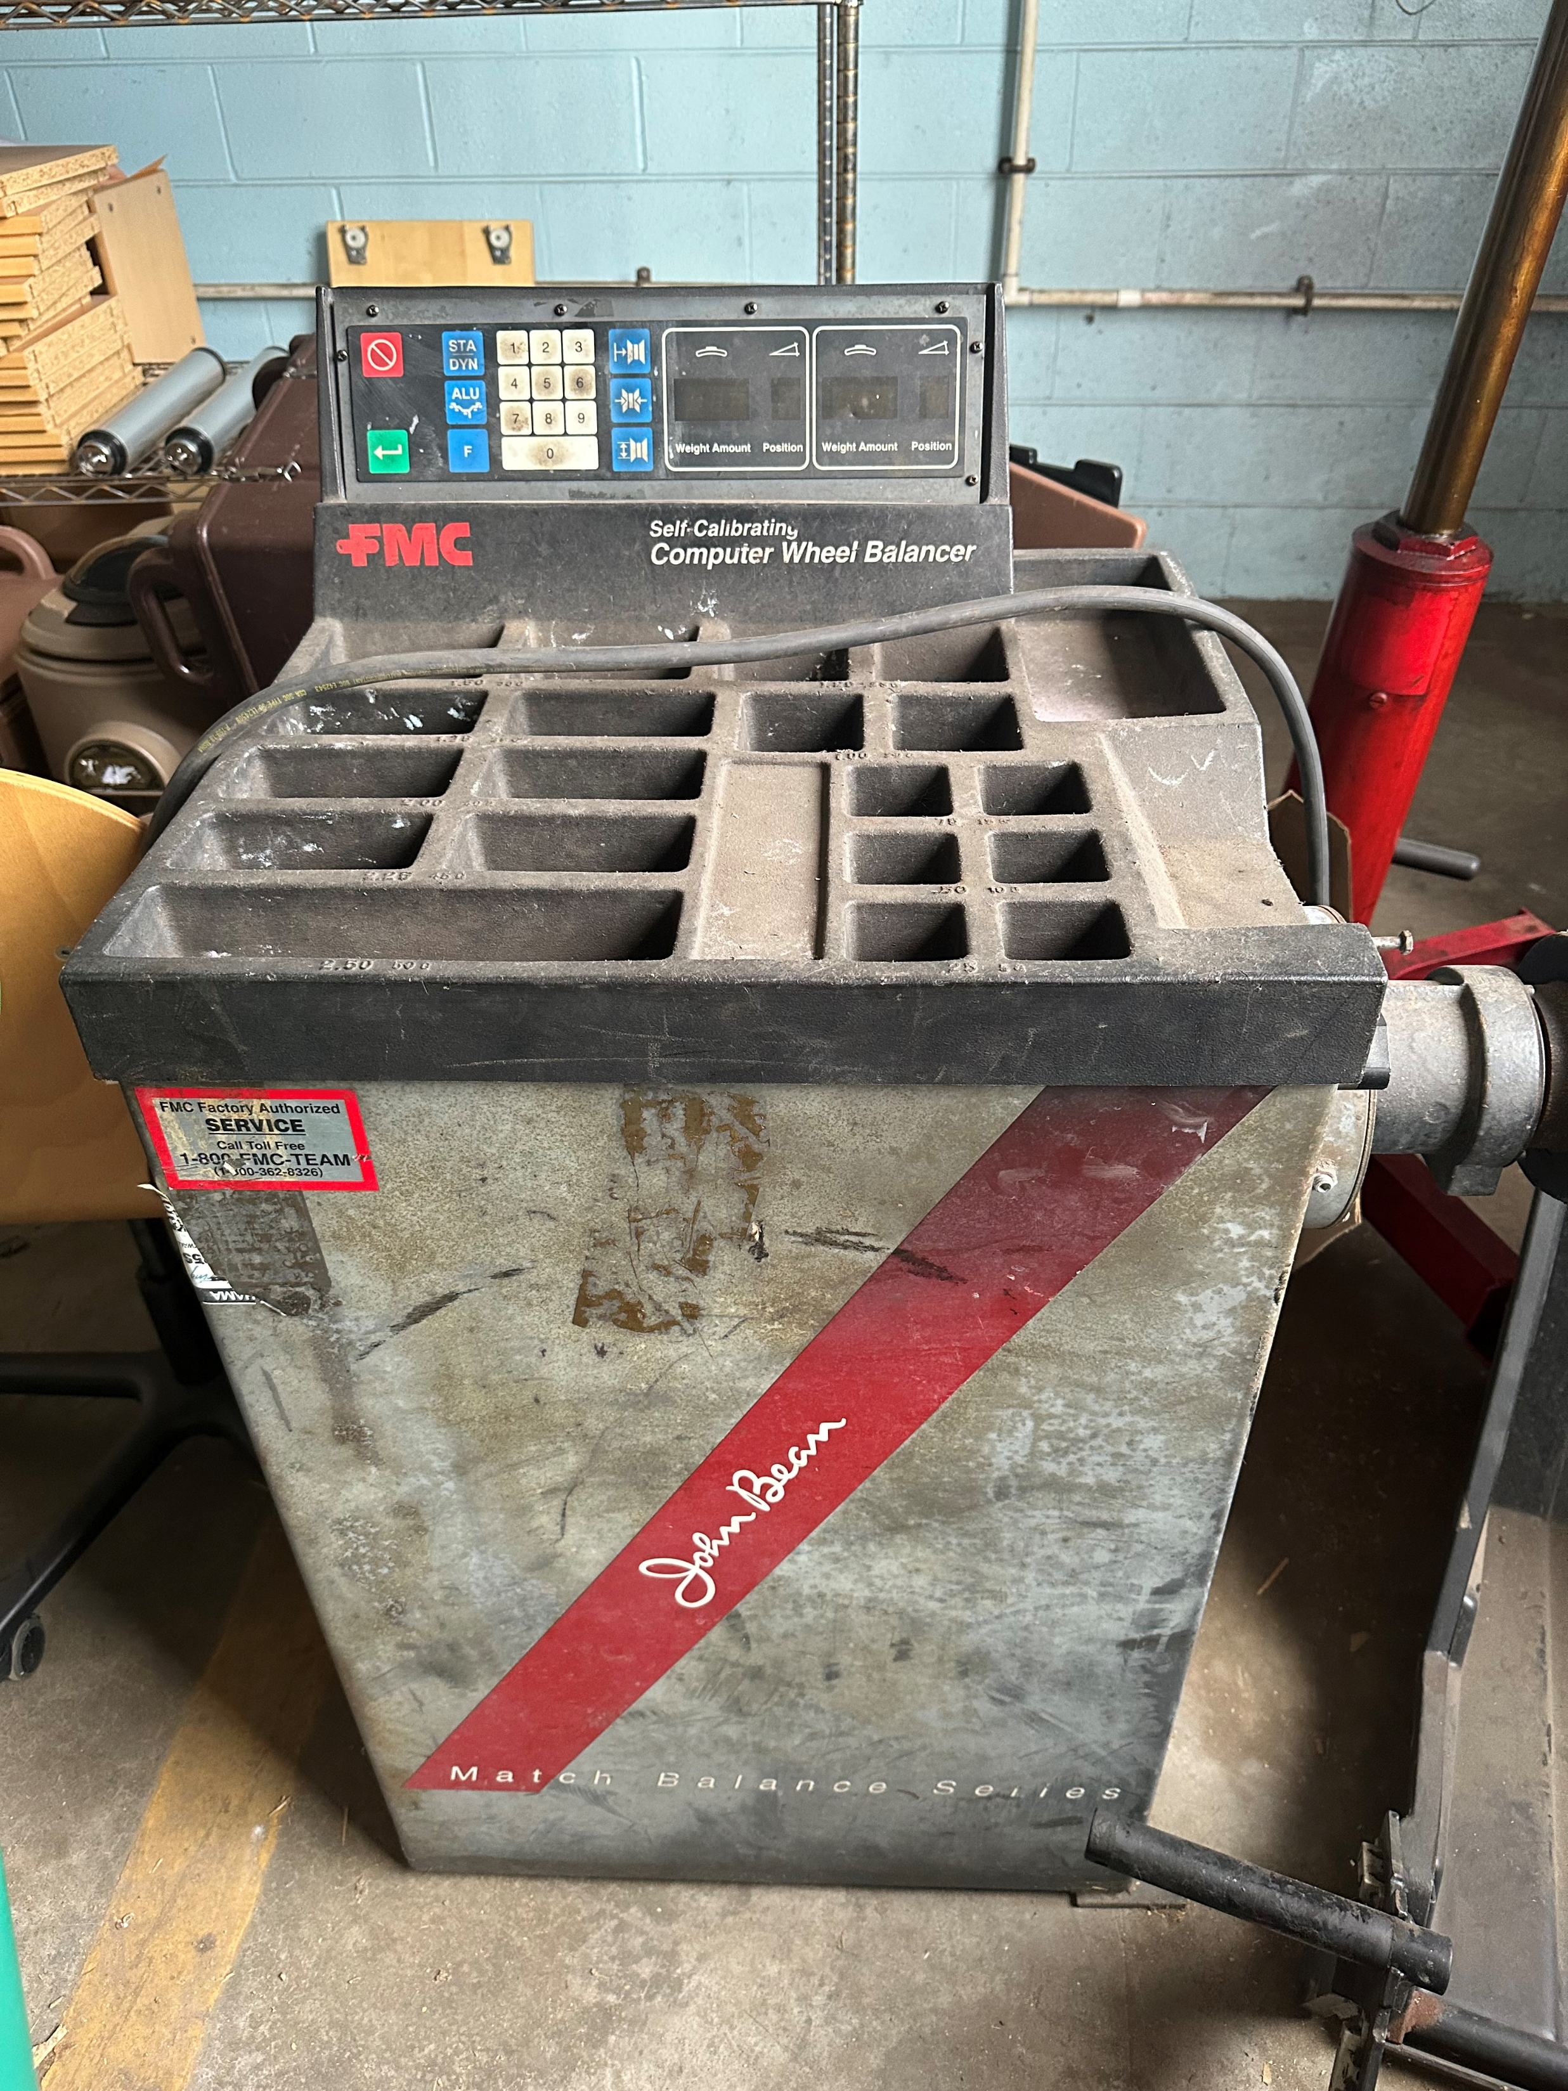
ITEM #6 Computer Wheel Balancer

Slide 8
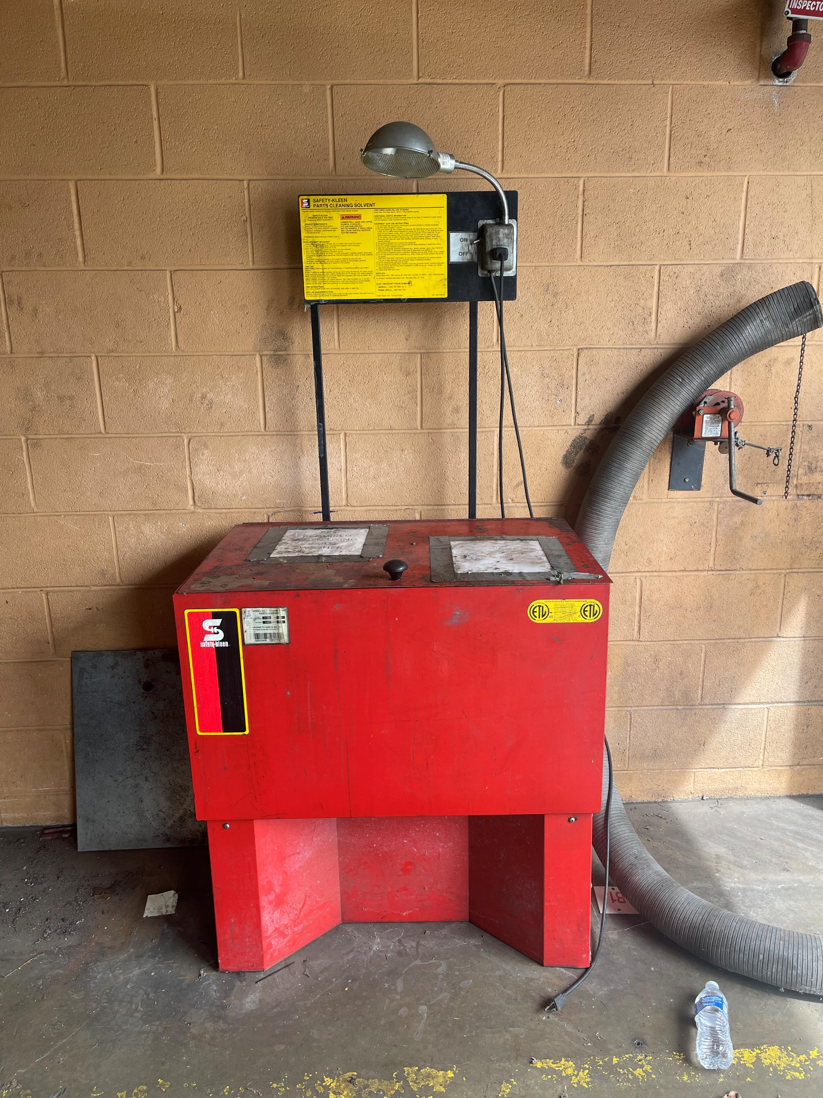
Item #7 Safety Kleen
This item can be viewed 5 June from 1600-1800
Call 301-6193264 for location address

Slide 9
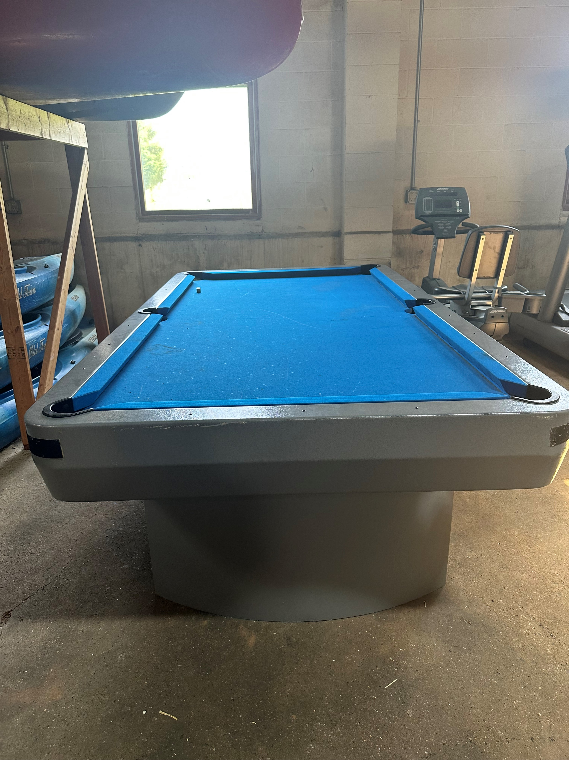
Item #8 Pool Table
This item can be viewed on 1 June from 1000-1200
Location:260 Beasley Drive

Slide 10
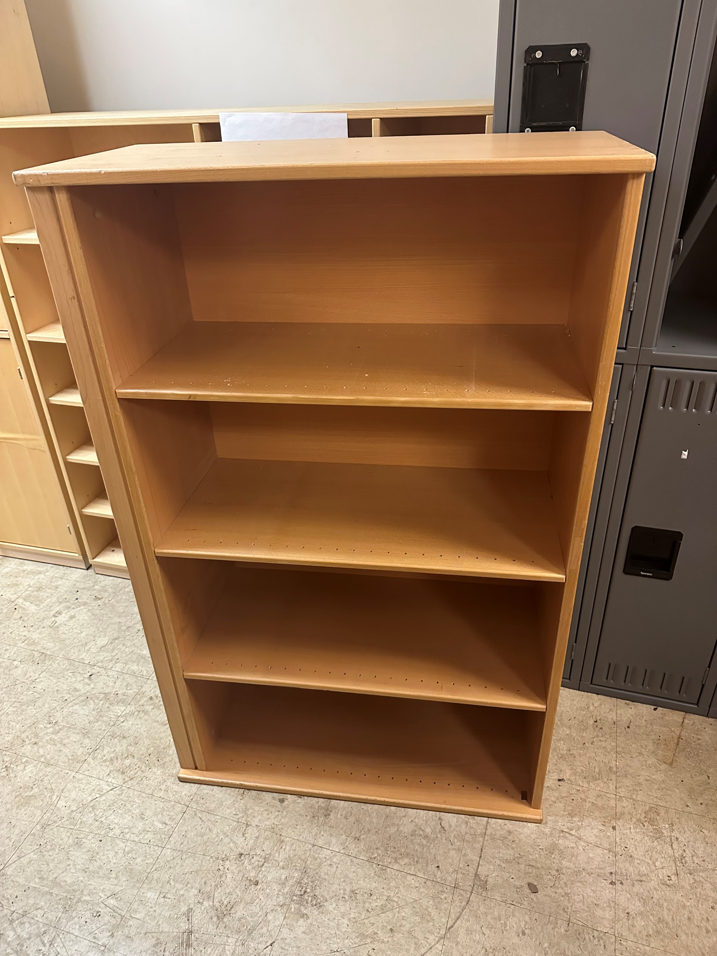
Item #9
Wooden Book Shelf

Slide 11
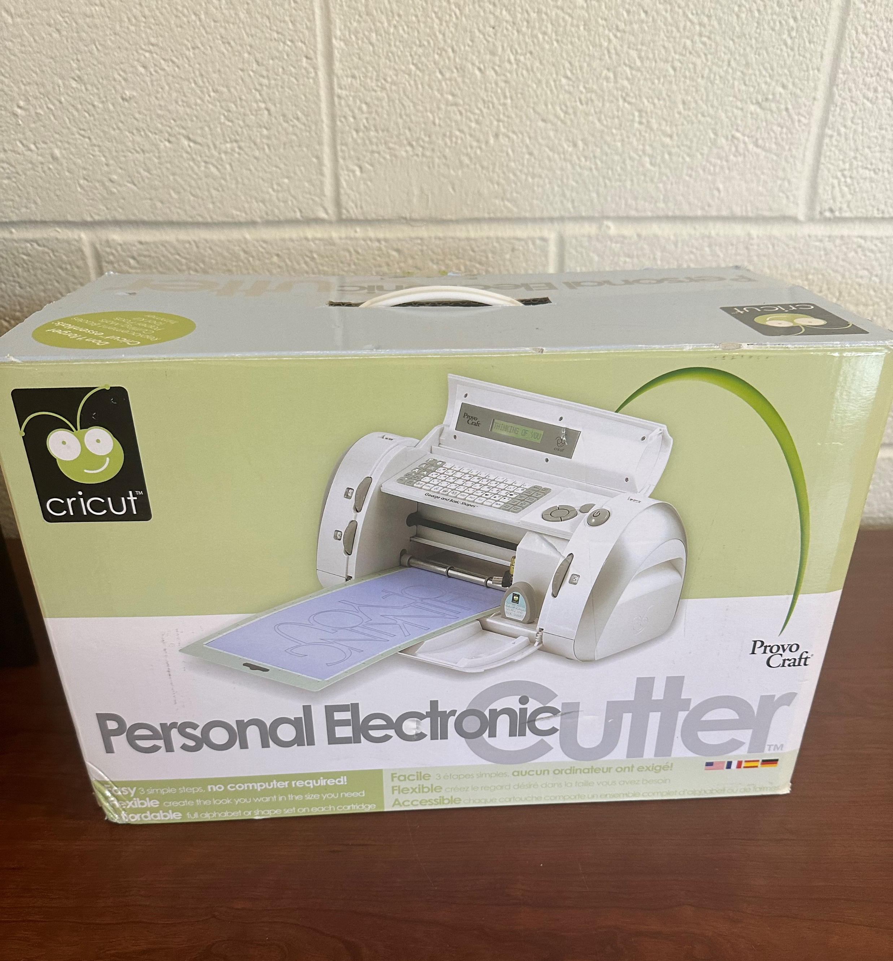
Item #10
Cricut Personal Electric Cutter

Slide 12

ITEM #10
Cricut Personal Electric Cutter

Slide 13
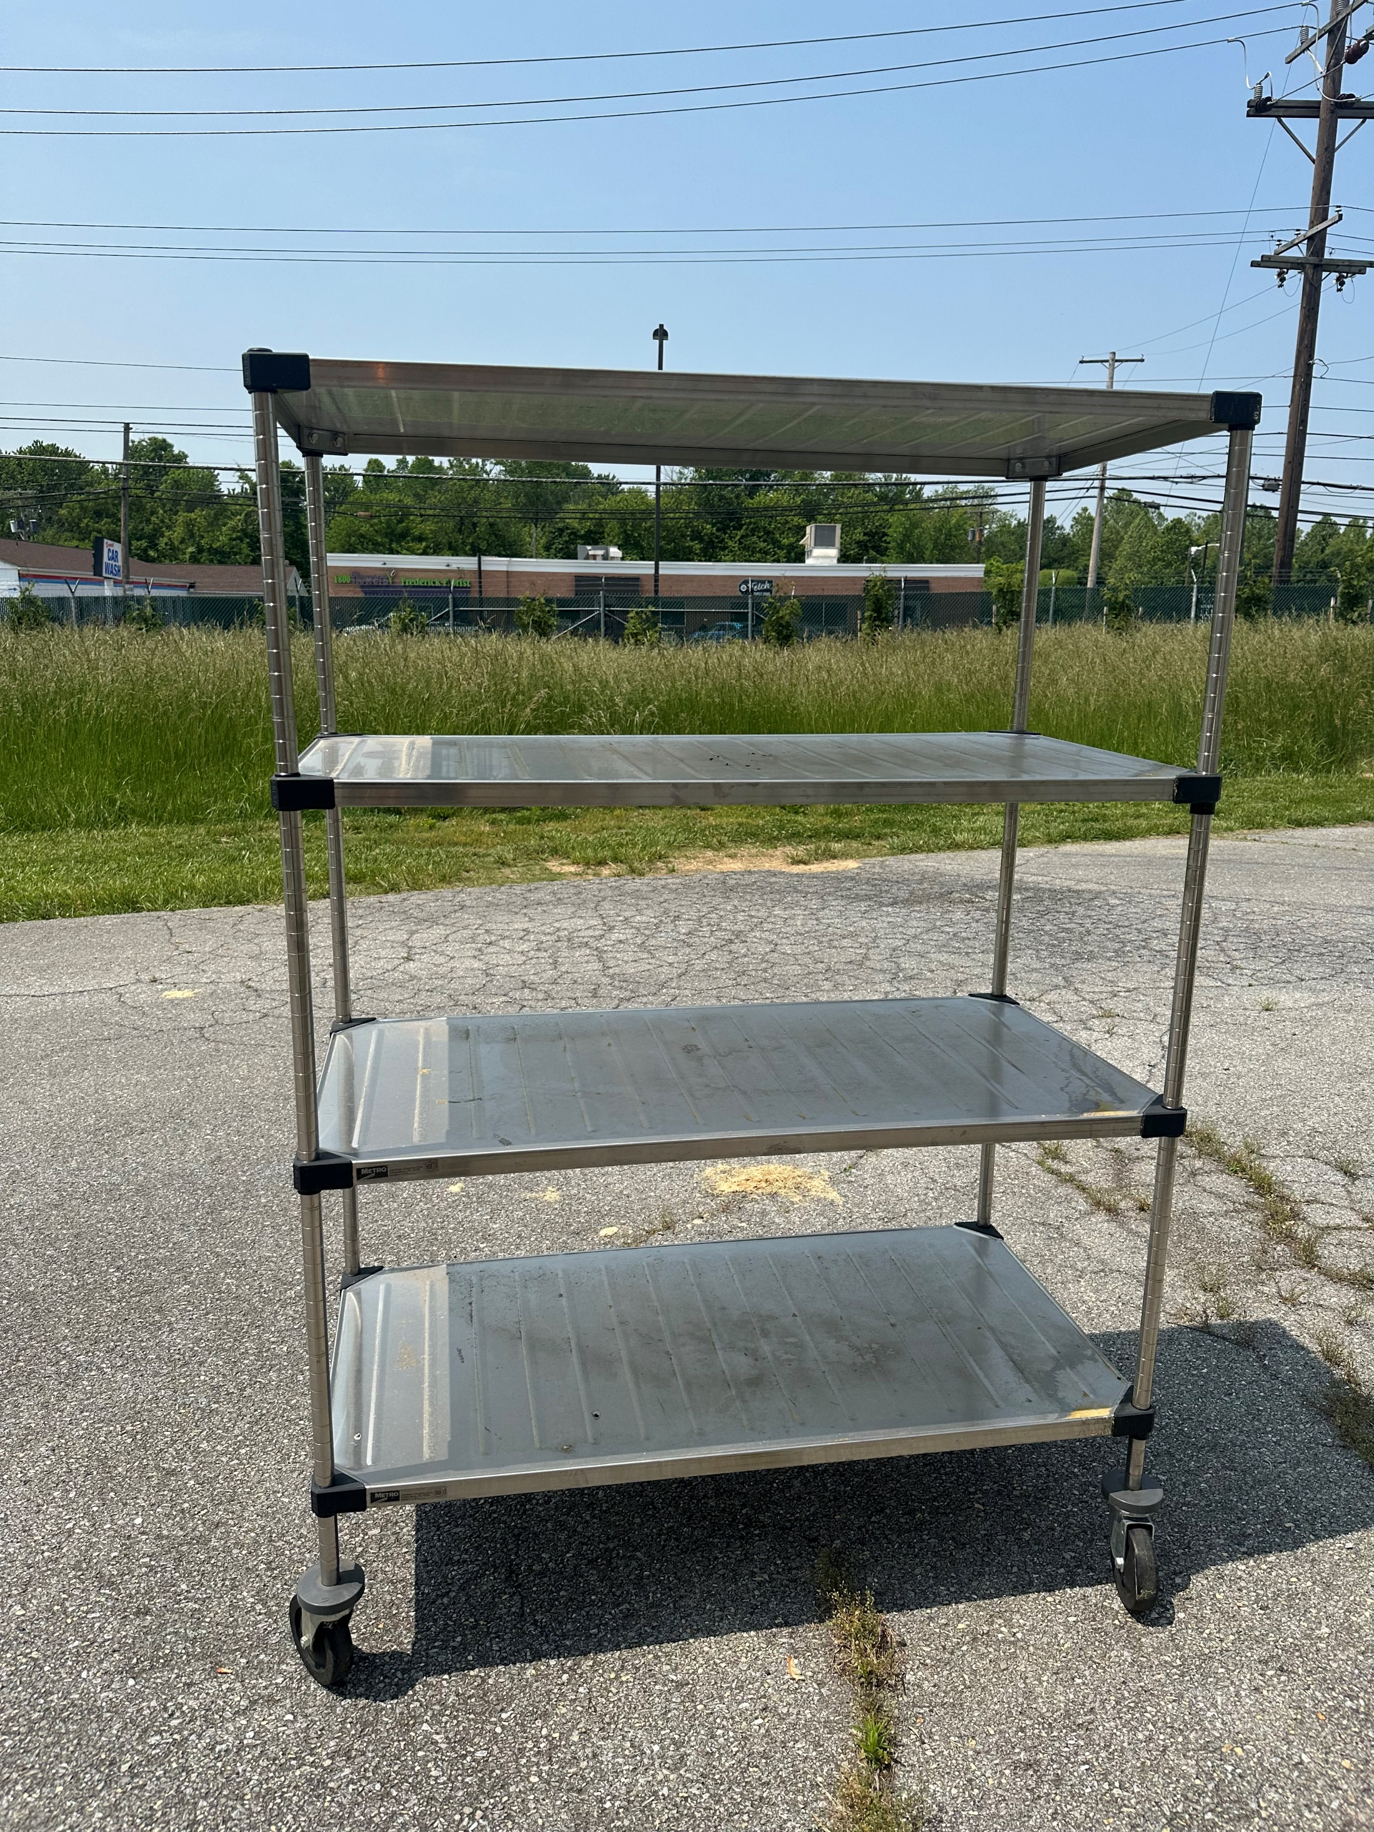
ITEM #11
3 Layer Storage Cart

Slide 14
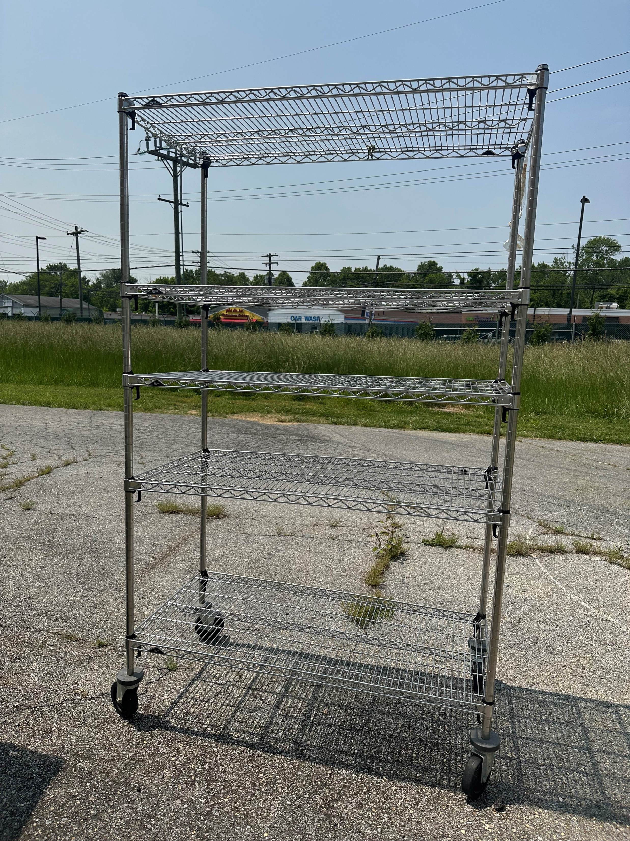
ITEM #12
4 Layer Storage Cart

