Slide 1
NAF Auction Auto Shop
Fort Detrick MWR

Slide 2
Item 1: Black storage shelf (6 available)

Slide 3
Item 2: Tire change system 50-70

Slide 4
Item 3: Tire change system 50-30

Slide 5
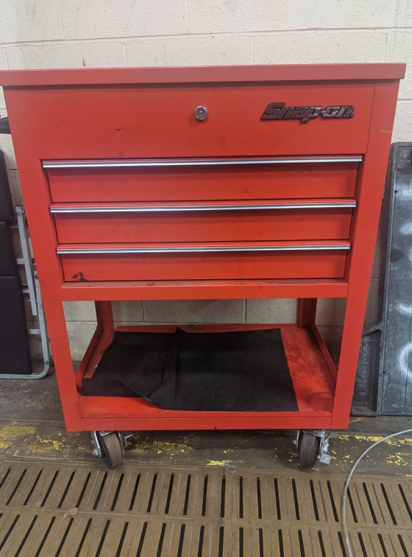
Item 4: Snap-on red drawers (1 available)

Slide 6
Item 5: Miscellaneous Drawer Set

Slide 7
Item 6: Coca-Cola drink cooler

Slide 8
Item 8: Metal Grinding Station

Slide 9
Item 9: Rolling Engine hoist

Slide 10
Item 10: Omega Lift hydraulic transmission jack

Slide 11
Item 11: refrigerator and microwave (set)

Slide 12
Item 12: Pump unit car wash

Slide 13
Item 13: Shop vac vacuum

Slide 14
Item 14: Gas canister holder

Slide 15
Item 15: DAYCO Hose and Tubing Station

Slide 16
Item 16: ATV and Motorcycle life

Slide 17
Item 17: hydraulic transmission jack 1.5 ton in box

Slide 18
Item 18: hydraulic transmission jack one ton in box

Slide 19
Item 19: Coats Tire Balancer 850

Slide 20
Item 20: Tire Balancer

Slide 21
Item 21: Transmission jack

Slide 22
Item 22: Transmission jack

Slide 23
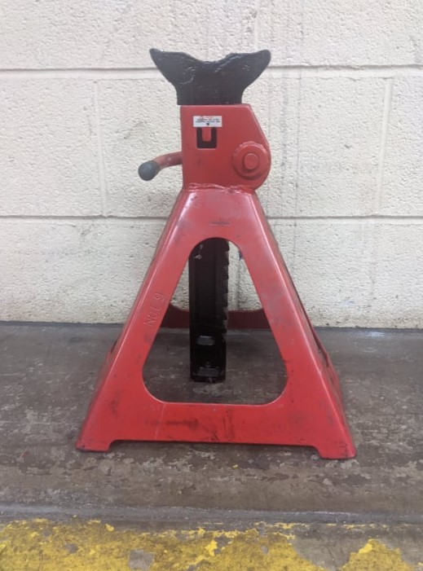
Item 23: black and red Truck jacks (set of 4)

Slide 24
Item 24: black and yellow jack stands (Set of 2)

Slide 25
Item 25: Car jack

Slide 26
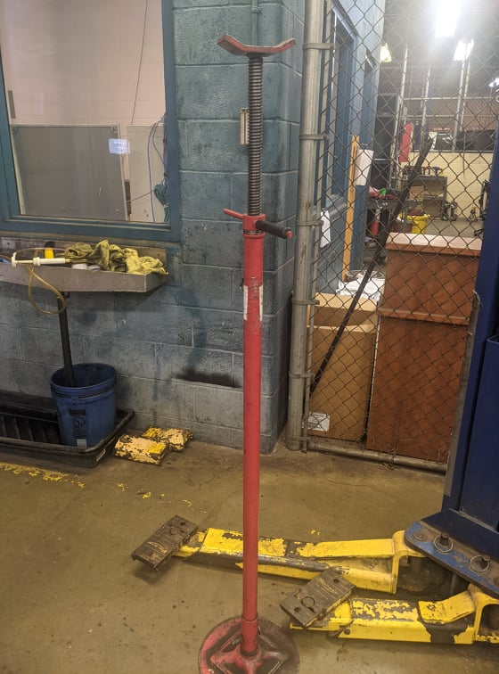
Item 26: Exhaust jack (set of 2)

Slide 27
Item 27: Dolly (SET OF 2)

Slide 28
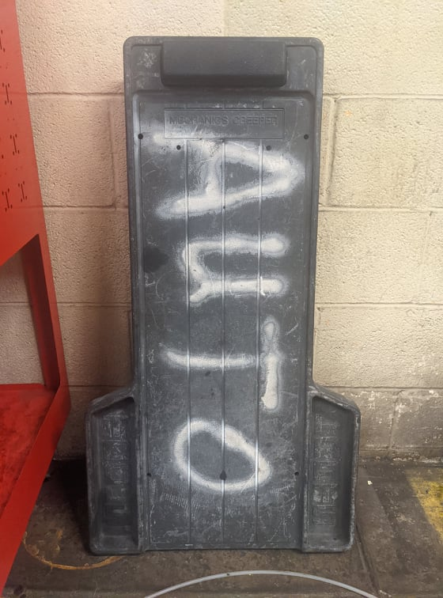
Item 28: Creeper

Slide 29
Item 29: justrite safety can (set of 2)

Slide 30
Item 30: containers (set of 2)

Slide 31
Item 31: comfortable chair (2) set

Slide 32
Item 32: snap on yaz240a mig welding system

Slide 33
Item 33: snap on muscle mig welder mm140sl

Slide 34
Item 34: Arc Welders (set of 2)

Slide 35
Item 35: Delta Sanding Station

Slide 36
Item 36: Hydraulic Press

Slide 37
Item 37: Rockwell Model 15 Drill Press

Slide 38
Item 38: Miscellaneous items on shelf 1 (shelf included)

Slide 39
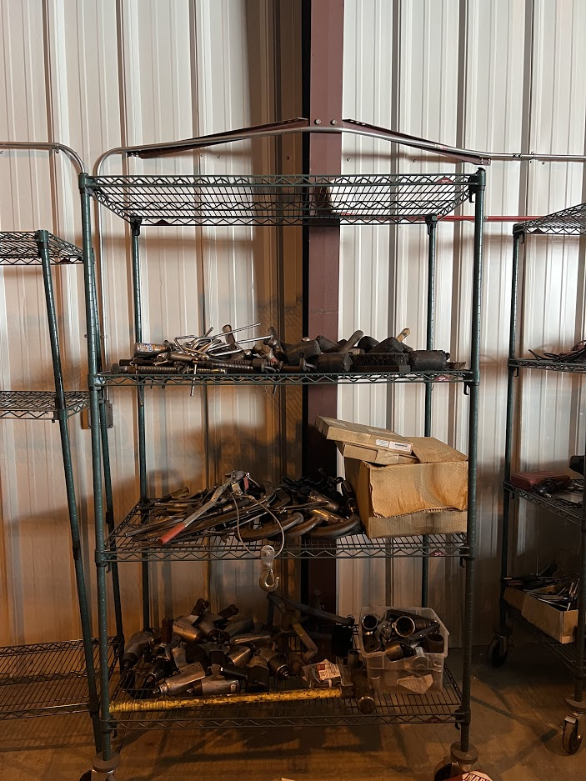
Item 39: Miscellaneous items on shelf 2 (shelf included)

Slide 40
Item 40: Miscellaneous items on shelf 3 (shelf included)

Slide 41
Item 41: Large floor fan

Slide 42
Item 42: tall fan

Slide 43
Item 43: creeper z 2 Available

Slide 44
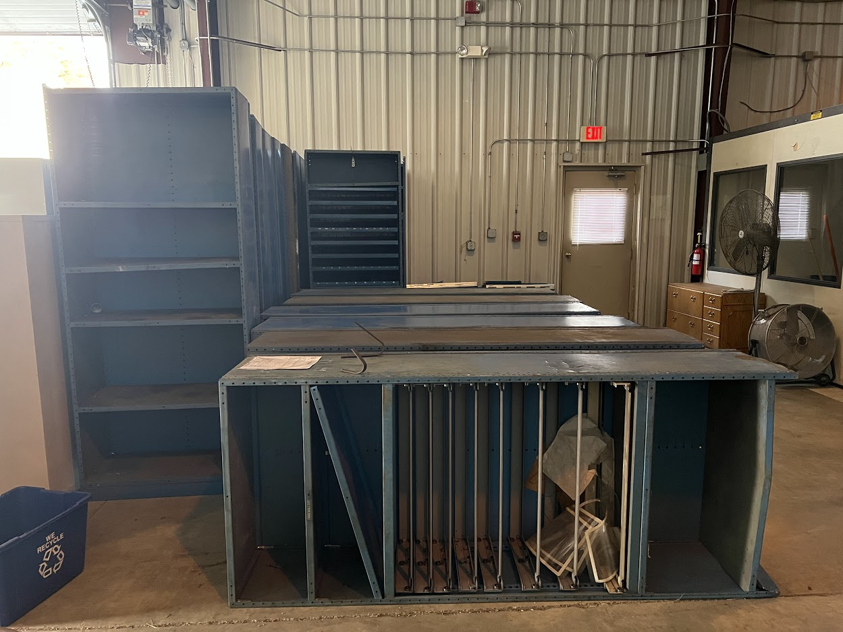
Item 44: Assorted blue shelves (20 available)

Slide 45
Item 45: yellow cabinets (3 available)

Slide 46
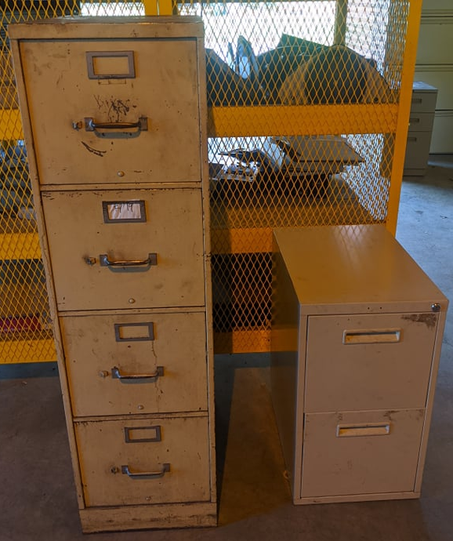
Item 46: assorted office cabinets Set

Slide 47
Item 47: Assorted oil drains (9 available)

Slide 48
Item 48: Ladders (set of 2)

Slide 49
Item 49: brake pump system

Slide 50
Item 50: boat motors (6 available)

Slide 51
Item 51: Miscellaneous tools (set)

Slide 52
Item 52: miscellaneous tools (set)

Slide 53
Item 53: Miscellaneous wrenches

Slide 54
Item 54:Bucket of Sockets

Slide 55
Item 55:Bucket of Parts

Slide 56
Item 56: Bucket of Parts

Slide 57
Item 57:Bucket of Parts

Slide 58
Item 58:Bucket of Parts

Slide 59
Item 59:Bucket of Parts

Slide 60
Item 60: Snap-on tool storage (set of 4)

Slide 61
Item 61: work table with Vise

Slide 62
Item 62: Work table

